Slide 1
Case studies
A personal insulin pump
An embedded system in an insulin pump used by diabetics to maintain blood glucose control.
A mental health care patient management system(MHC-PMS)
A system used to maintain records of people receiving care for mental health problems.

Slide 2
Insulin pump control system
Collects data from a blood sugar sensor and calculates the amount of insulin required to be injected.
Calculation based on the rate of change of blood sugar levels.
Sends signals to a micro-pump to deliver the correct dose of insulin.
Safety-critical system as low blood sugars can lead to brain malfunctioning, coma and death; high-blood sugar levels have long-term consequences such as eye and kidney damage.

Slide 3
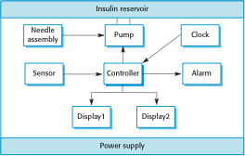
Insulin pump hardware architecture

Slide 4
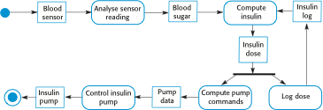
Activity model of the insulin pump

Slide 5
Essential high-level requirements
The system shall be available to deliver insulin when required.
The system shall perform reliably and deliver the correct amount of insulin to counteract the current level of blood sugar.
The system must therefore be designed and implemented to ensure that the system always meets these requirements.

Slide 6
A patient information system for mental health care
A patient information system to support mental health care is a medical information system that maintains information about patients suffering from mental health problems and the treatments that they have received.
Most mental health patients do not require dedicated hospital treatment but need to attend specialist clinics regularly where they can meet a doctor who has detailed knowledge of their problems.
To make it easier for patients to attend, these clinics are not just run in hospitals. They may also be held in local medical practices or community centres.

Slide 7
MHC-PMS
The MHC-PMS (Mental Health Care-Patient Management System) is an information system that is intended for use in clinics.
It makes use of a centralized database of patient information but has also been designed to run on a PC, so that it may be accessed and used from sites that do not have secure network connectivity.
When the local systems have secure network access, they use patient information in the database but they can download and use local copies of patient records when they are disconnected.

Slide 8
MHC-PMS goals
To generate management information that allows health service managers to assess performance against local and government targets.
To provide medical staff with timely information to support the treatment of patients.

Slide 9
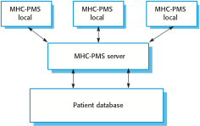
The organization of the MHC-PMS

Slide 10
MHC-PMS key features
Individual care management
Clinicians can create records for patients, edit the information in the system, view patient history, etc. The system supports data summaries so that doctors can quickly learn about the key problems and treatments that have been prescribed.
Patient monitoring
The system monitors the records of patients that are involved in treatment and issues warnings if possible problems are detected.
Administrative reporting
The system generates monthly management reports showing the number of patients treated at each clinic, the number of patients who have entered and left the care system, number of patients sectioned, the drugs prescribed and their costs, etc.

Slide 11
MHC-PMS concerns
Privacy
It is essential that patient information is confidential and is never disclosed to anyone apart from authorised medical staff and the patient themselves.
Safety
Some mental illnesses cause patients to become suicidal or a danger to other people. Wherever possible, the system should warn medical staff about potentially suicidal or dangerous patients.
The system must be available when needed otherwise safety may be compromised and it may be impossible to prescribe the correct medication to patients.

